Slide 1

Applying Supervised Learning to the Bank Marketing Dataset
Thinkful Data Science Supervised Learning Capstone
Roy Shabaya

Slide 2
Introduction
Data
Marketing response data obtained from UCI Machine Learning Repository - Portuguese bank using telemarketing to offer their customers a term deposit product
Data includes demographic information on the customer, the banks information on the campaign, as well as macro-economic data
Research Topic: Can we predict whether a customer will purchase the product, given basic demographic, campaign, and economic data.
Purpose: Being able to predict whether a customer will make a purchase can help a company maximize their marketing efforts

Slide 3
Data Exploration – Initial Insights
88.8% of the data is from the majority class, customers that did not make a purchase - Baseline
There are 41,188 observations, across 21 features
3 Sections of Data:
Customer – Age, Job, Marital, Education, Housing, etc. (1/8 numerical)
Campaign – Number of contacts, day of week, duration, previous outcomes (4/8 numerical)
Macro Economic – CPI, Employment variation rate, CCI, Number of employees(5/5 numerical)

Slide 4
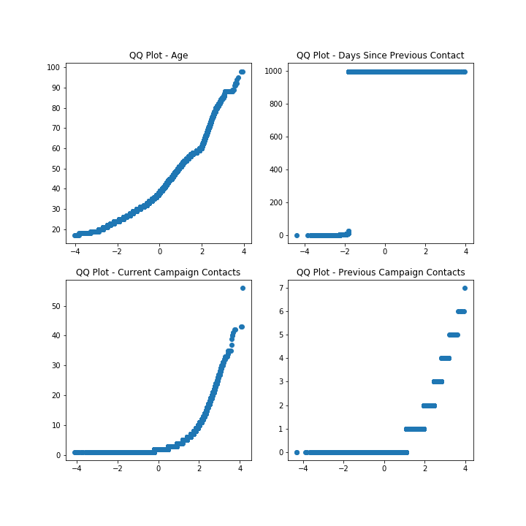
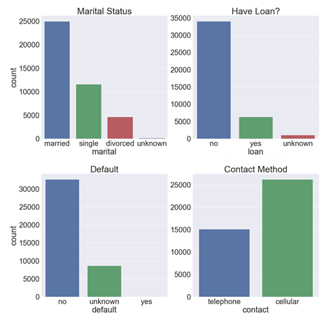
Exploring the Data…
Numerical Features – QQ Plots
Categorical Features - Count Bar Plots

Slide 5
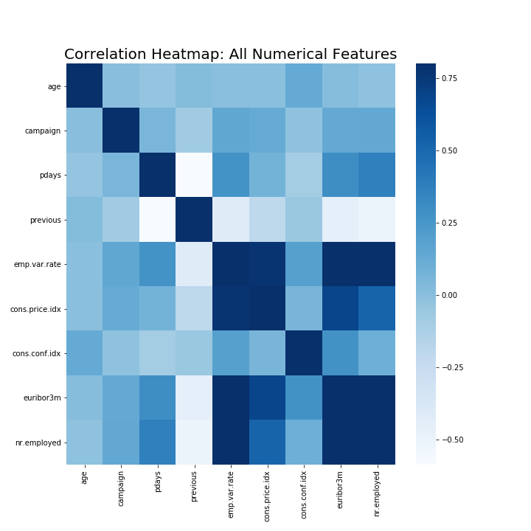
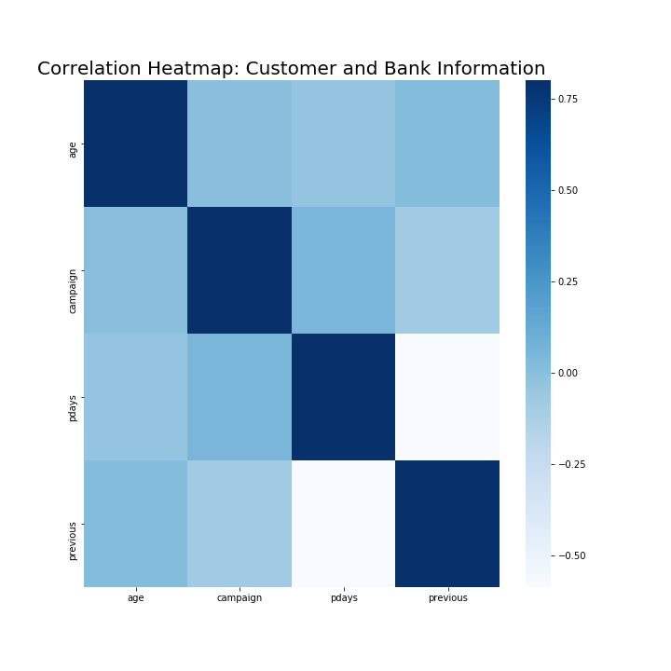
Feature Correlation
Looking a the full data set we can see high correlation between the macroeconomic features.
Previous and pdays are negatively correlated due a coding quirk, if a customer has not been previously contacted pdays has a value of 999, while previous has 0.

Slide 6
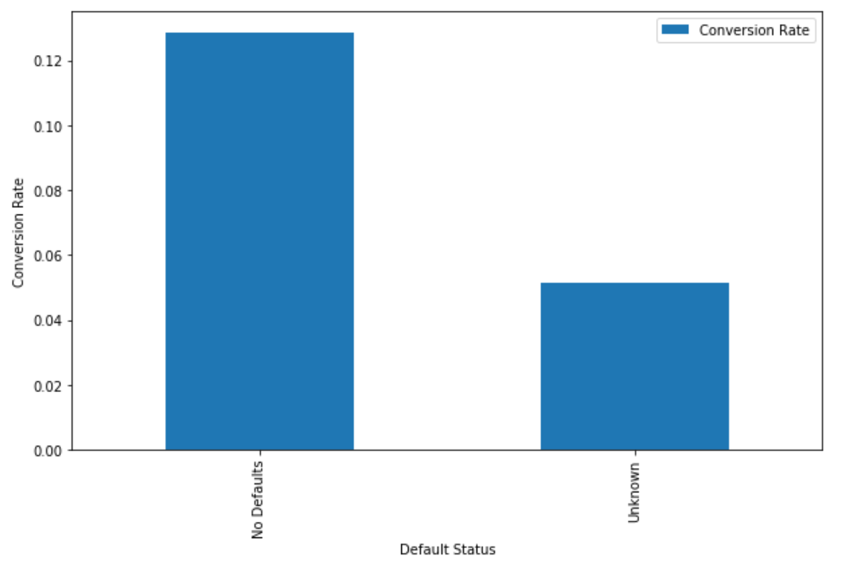
Conversion Rate : Past Defaults

Slide 7
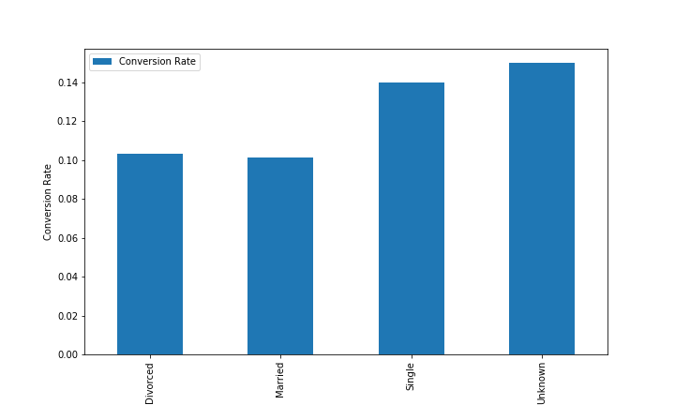
Conversion Rate : Marital Status

Slide 8
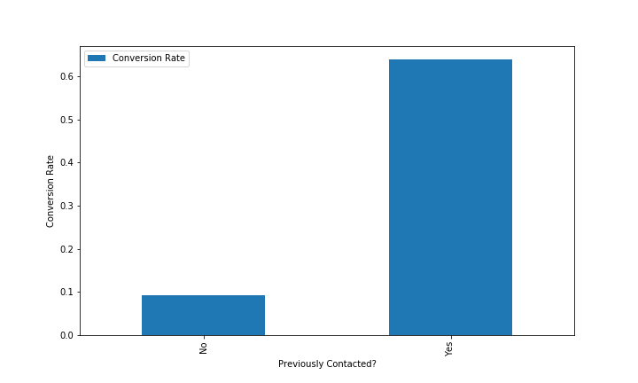
Conversion Rate : Previously Contacted
legend.remove()

Slide 9
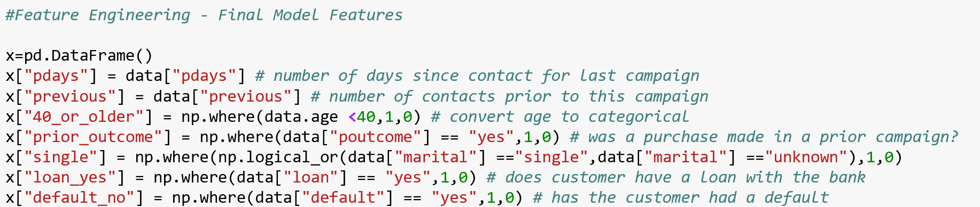
Feature Engineering
Created features based on insights learned from exploration
Most of the customer and bank data was categorical – created dummy features
Attempted to identify interactions, as well as whether transformations would help performance
Transformed several numerical variables to categorical

Slide 10
Feature Selection
Several methods were used for feature selection:
Coefficients from Lasso
Principal Component Analysis
Random Forest Feature Importance
Backwards Pass Feature Elimination
Recursive Feature Elimination
Data did not contain information that was adequate for us to make reliable predictions on the outcome, whether a purchase was made (more on this later…)

Slide 11
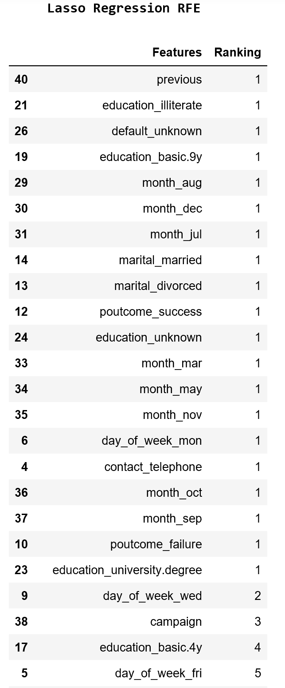
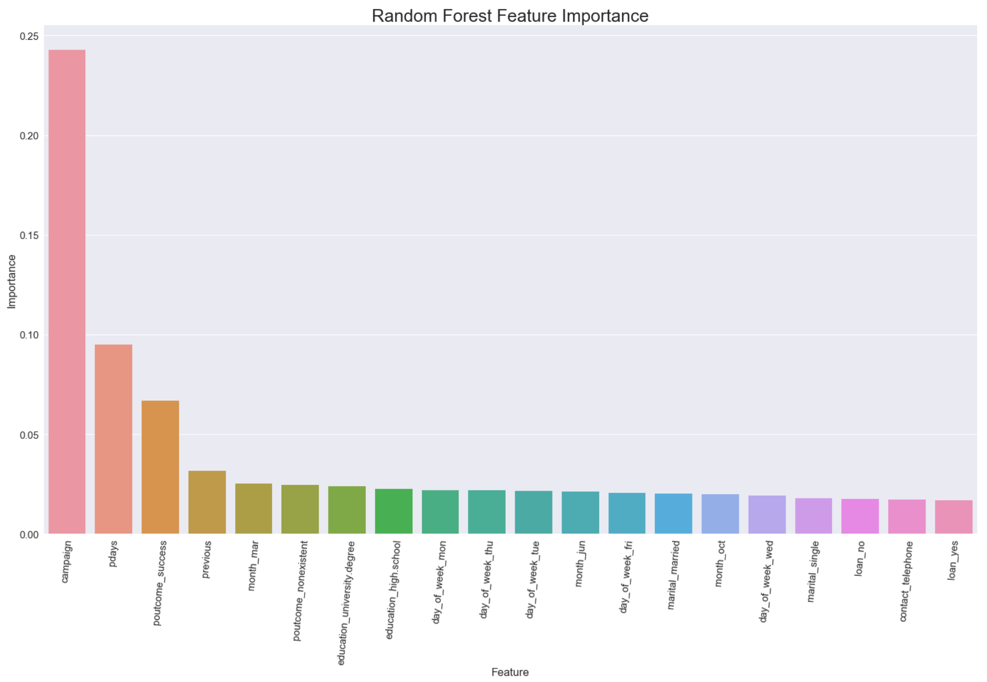

Slide 12

Measuring Model Performance
Sensitivity
Specificity
Probability that positive examples will be correctly identified
Customer making a purchase is our positive
Probability that negative examples will be correctly identified
Customers that don’t make a purchase are the negative
Accuracy
Mean accuracy of the overall model
Built in method for all models

Slide 13
Modeling
No models were able to able to produce significantly better results than the baseline of 88.8%
The best accuracy performer was KNN
The best performers measured by specificity were Lasso and Ridge Regression
Results
Model | Train Score | Test Score | Specificity | Sensitivity
KNN | 0.8985 | 0.8962 | 0.9874 | 0.1944
Random Forest | 0.9007 | 0.8961 | 0.9894 | 0.1775
Boosted Model | 0.9002 | 0.8958 | 0.9885 | 0.1817
Logistic Regression | 0.8983 | 0.8953 | 0.9844 | 0.2088
Support Vector | 0.8982 | 0.8953 | 0.9844 | 0.2087
Lasso Regression | 0.8221 | 0.8214 | 0.8878 | 0.3102
Ridge Regression | 0.8221 | 0.8214 | 0.8878 | 0.3102

Slide 14
Random Forest
Overview
Parameters & Results
Pros:
Help understand feature importance
Doesn’t require input preparation(can handle numerical, binary, and categorical without scaling transformation or modification)
Cons:
Black box
Larger forests can be slow to run and be computationally intensive
Number of Estimators : (1 – 10,000) – 82 Optimal
Accuracy = .8961
Score = .1775

Slide 15
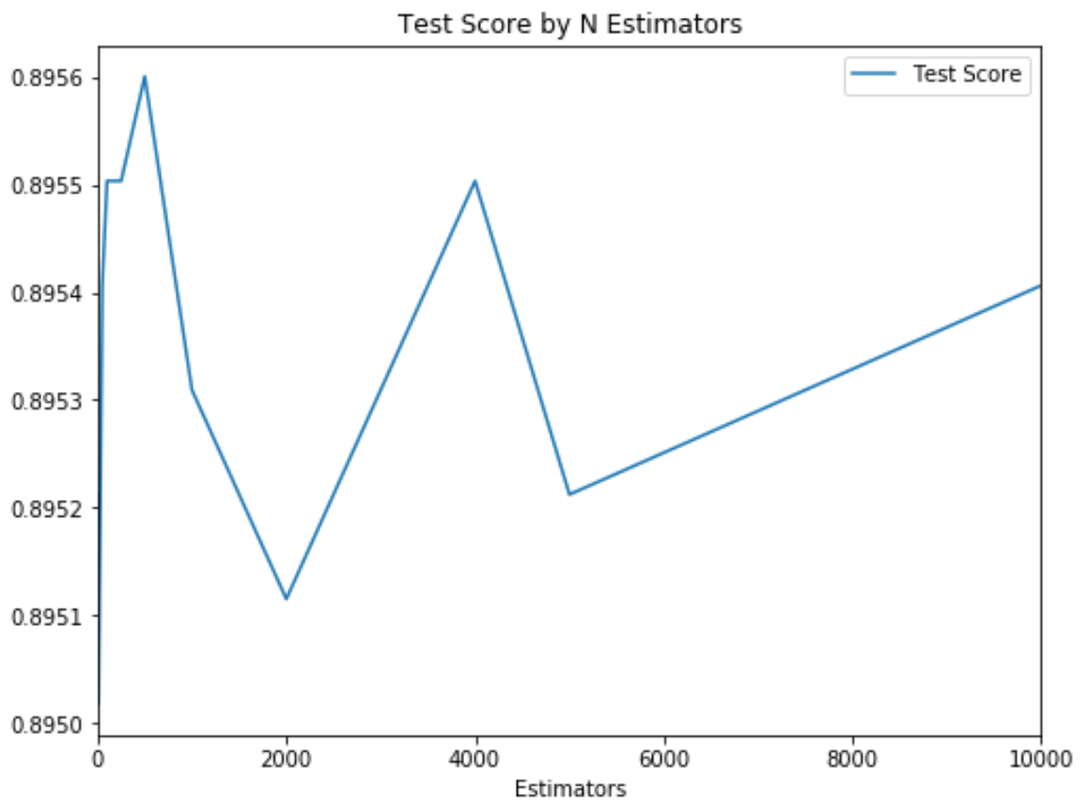
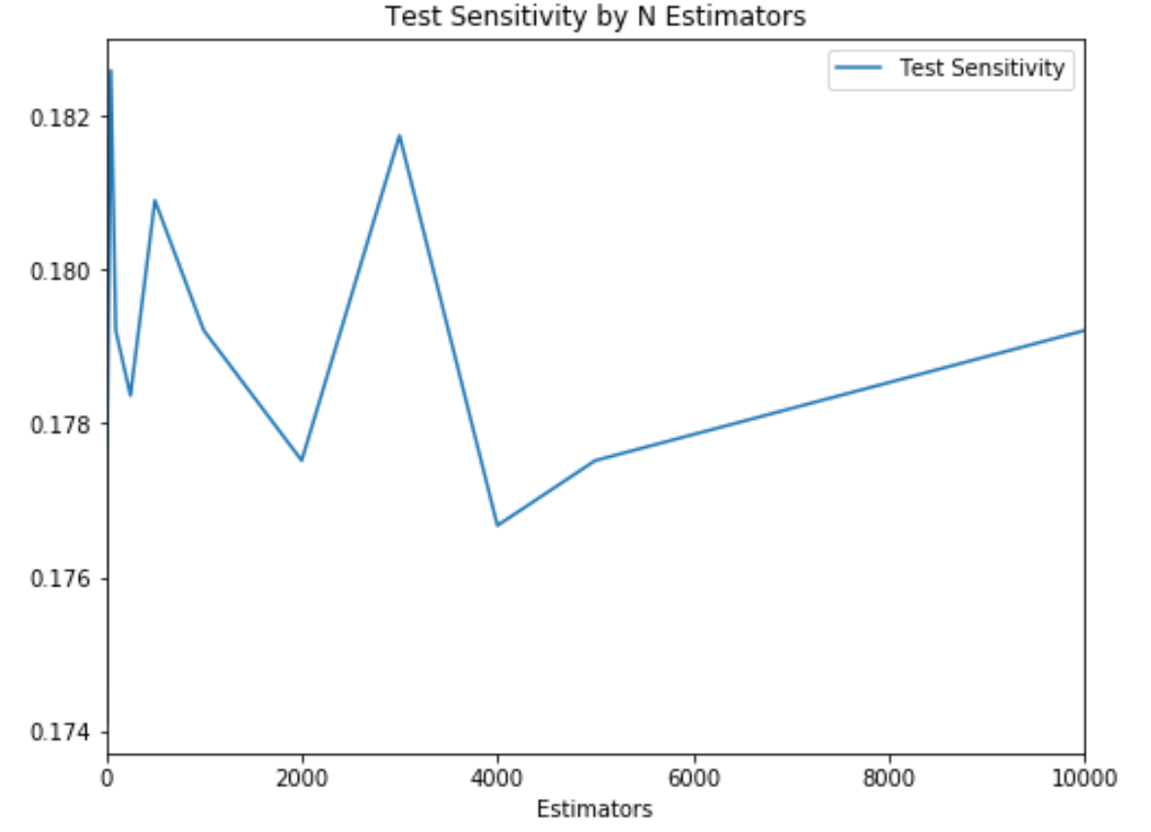
Random Forest

Slide 16
Logistic Regression
Overview
Parameters & Results
Pros:
Easy to interpret
Lasso – Zeros coefficients/feature selection
Ridge – Minimizes coefficients
Cons:
None of the models perform well on both Accuracy or Sensitivity
Logistic regression performed best on accuracy, class weight = None
Accuracy = .8963
Sensitivity = .1944
Lasso and Ridge performed best with sensitivity
Class weight = Balanced
Accuracy = .8214
Sensitivity = .3102

Slide 17
Support Vector
Overview
Parameters & Results
Pros:
Compared to other models performed well on sensitivity
Cons:
Computationally demanding
Picking right kernel is key – in comparison to Random Forest, etc.
Kernel – (RBF, Linear) - RBF Optimal
Class Weight – (None, Balanced) – None Optimal
Accuracy : .8953
Sensitivity : .2088

Slide 18
Gradient Boosted Model
Overview
Parameters & Results
Pros:
Used Itertools to test all parameter combinations
Feature selection is part of model process
Cons:
Can be computationally intensive with larger number of estimators and different parameter combinations
Parameter tuning essential, may not work well otherwise
Loss Types – (Deviance, Exponential) - Exponential Optimal
Max Depth – (1 – 8) – 5 Optimal
Estimators – (1 - 1,000) – 145 Optimal
Accuracy = .8958
Sensitivity = .1817

Slide 19
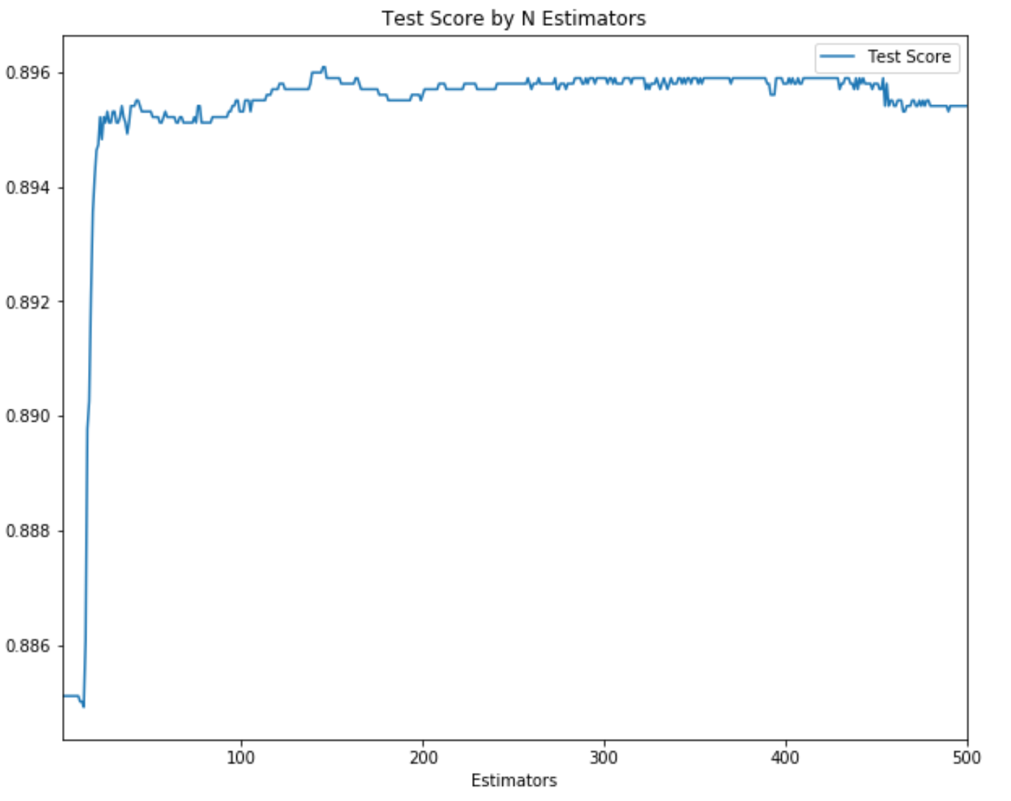
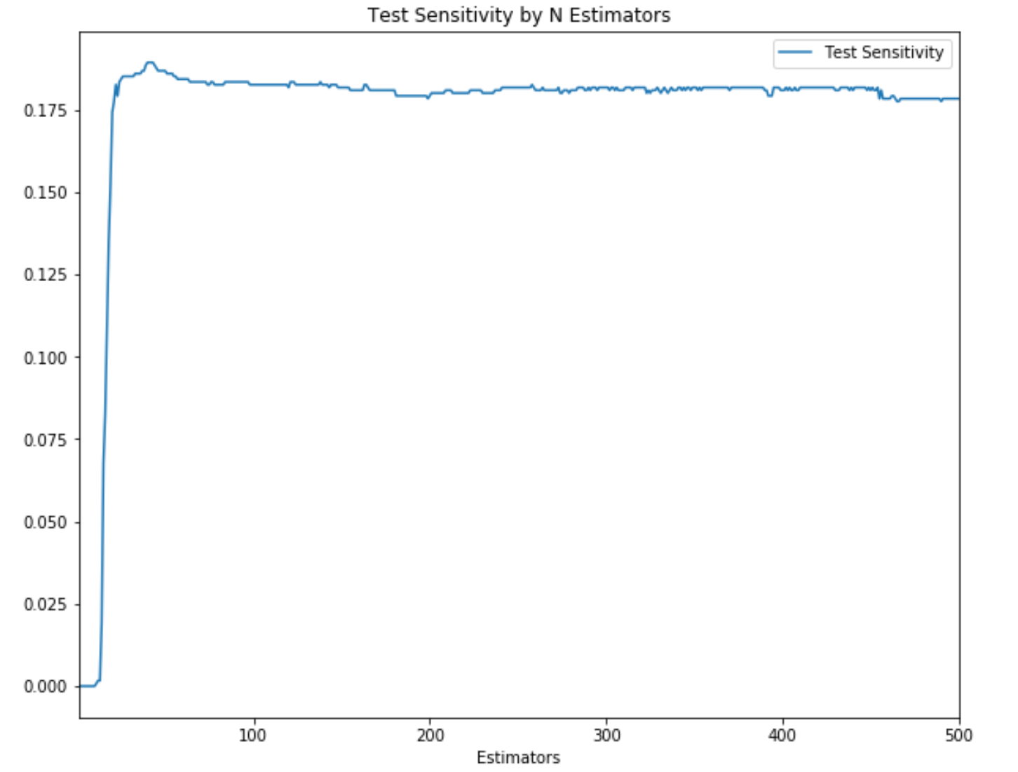
Gradient Boosted Model

Slide 20
KNN
Overview
Parameters & Results
Pros:
Really simple and fast training
Feature selection part of model
Cons:
Lazy learner – uses training data for classification
Can be slow during prediction
Weights – (Uniform, Distance) – Uniform Optimal
Neighbors – (1 – 105) – 46 Optimal
Accuracy = .8963
Sensitivity = .1944

Slide 21
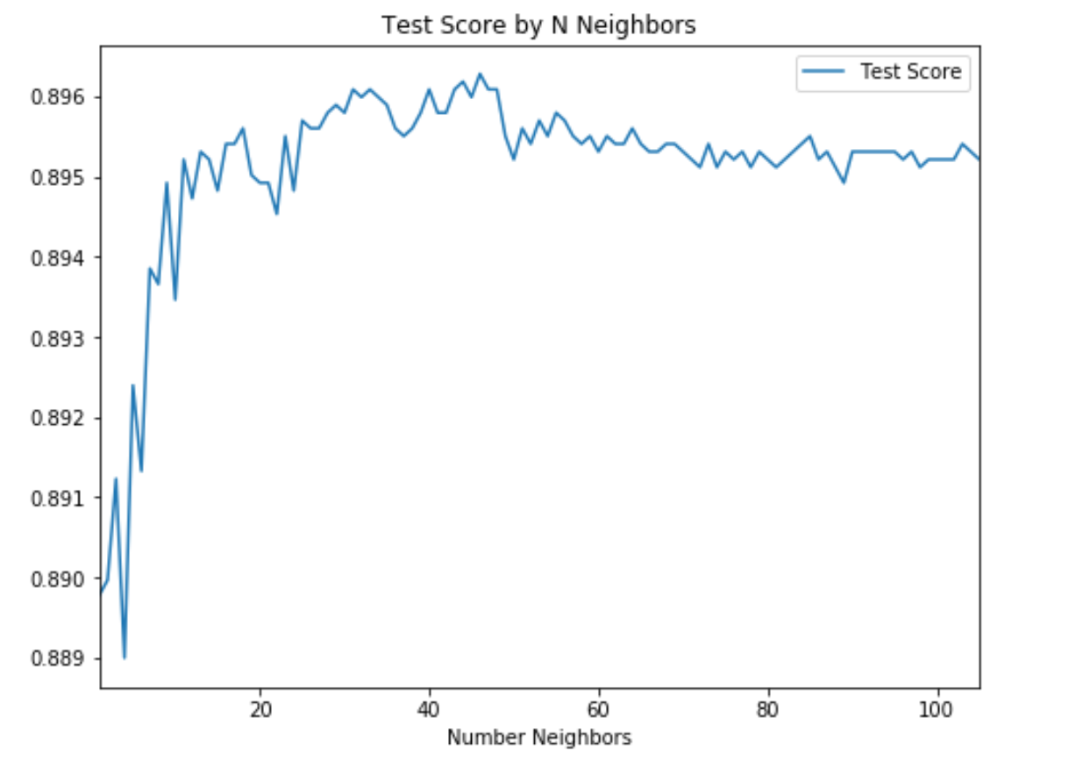
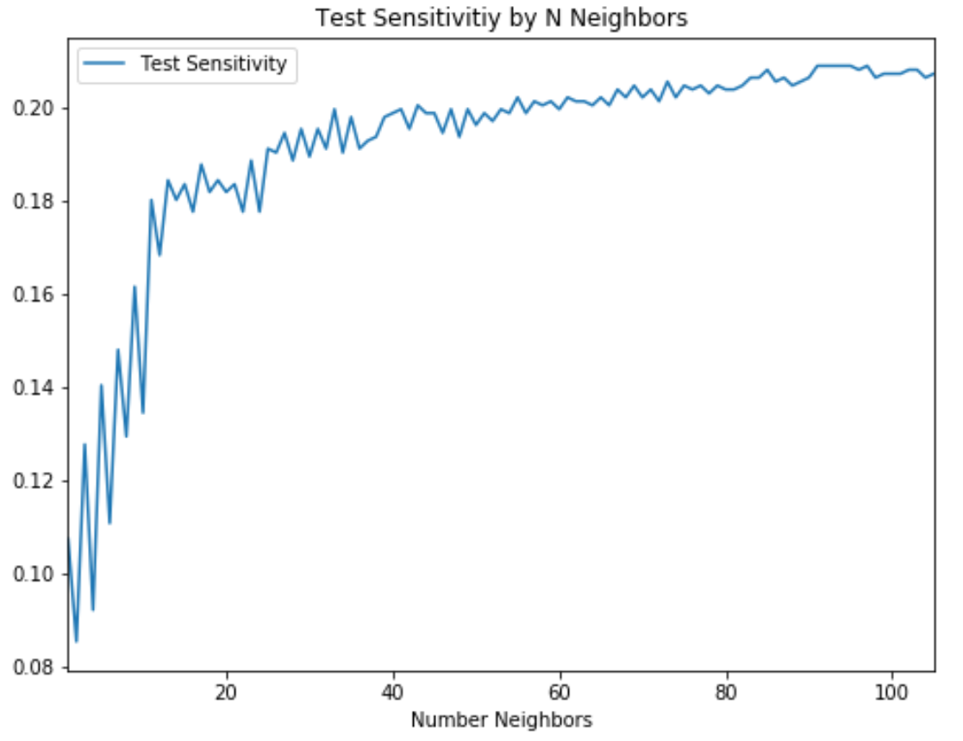
KNN

Slide 22
Conclusions
The data available did not allow for making predictions meaningfully better than baseline.
The only meaningful predictor, Previously Contacted – Yes, applied to a very small portion of the data so it didn’t help overall model performance.
Business scenario would dictate whether priority is improving accuracy or sensitivity – though would not deploy as it currently stands.
Best model for accuracy is KNN
Best models for sensitivity are Ridge and Lasso Regression
Additional data is needed to improve model performance – a larger private dataset used for research included information on the bank employee making the call, and additional customer information. As business case would have access to full dataset.

Slide 23
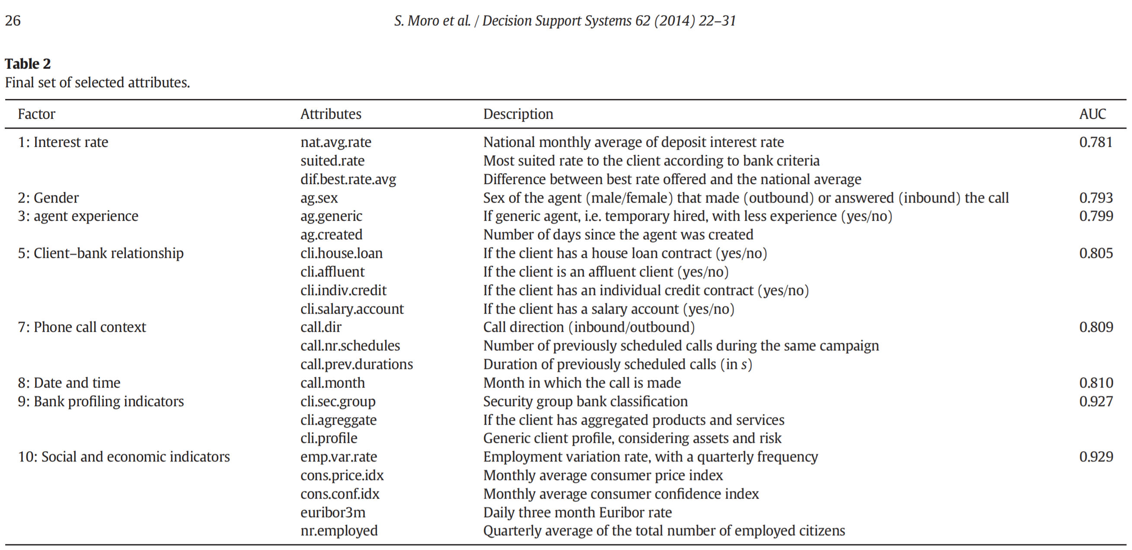

Slide 24
Thank You!

